Slide 1
Functions and an Introduction to Recursion
Chapter 6 of C++ How to Program, 9/e
©1992-2017 by Pearson Education, Inc. All Rights Reserved.

Slide 2
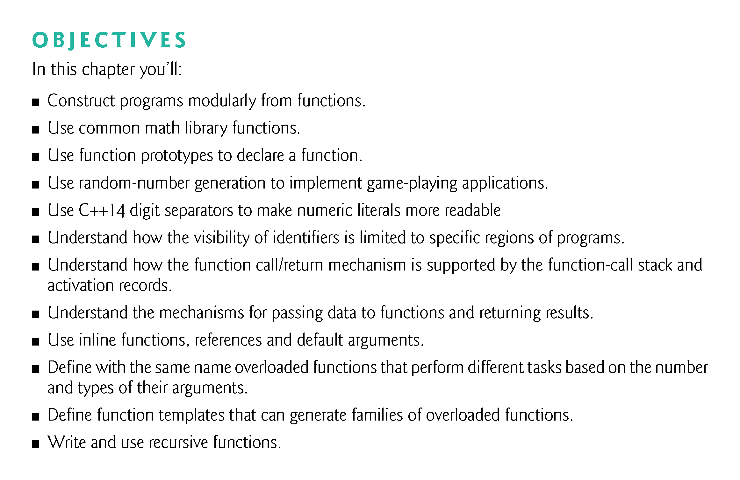
©1992-2017 by Pearson Education, Inc. All Rights Reserved.

Slide 3
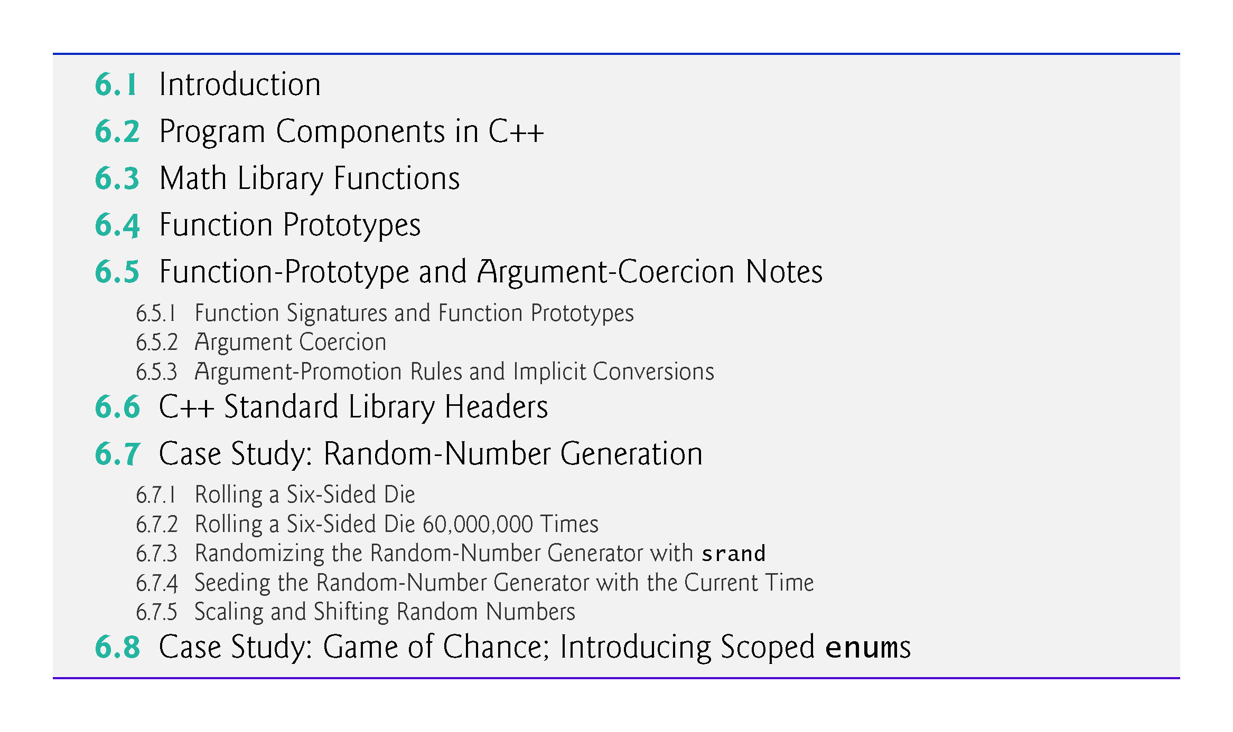
©1992-2017 by Pearson Education, Inc. All Rights Reserved.

Slide 4
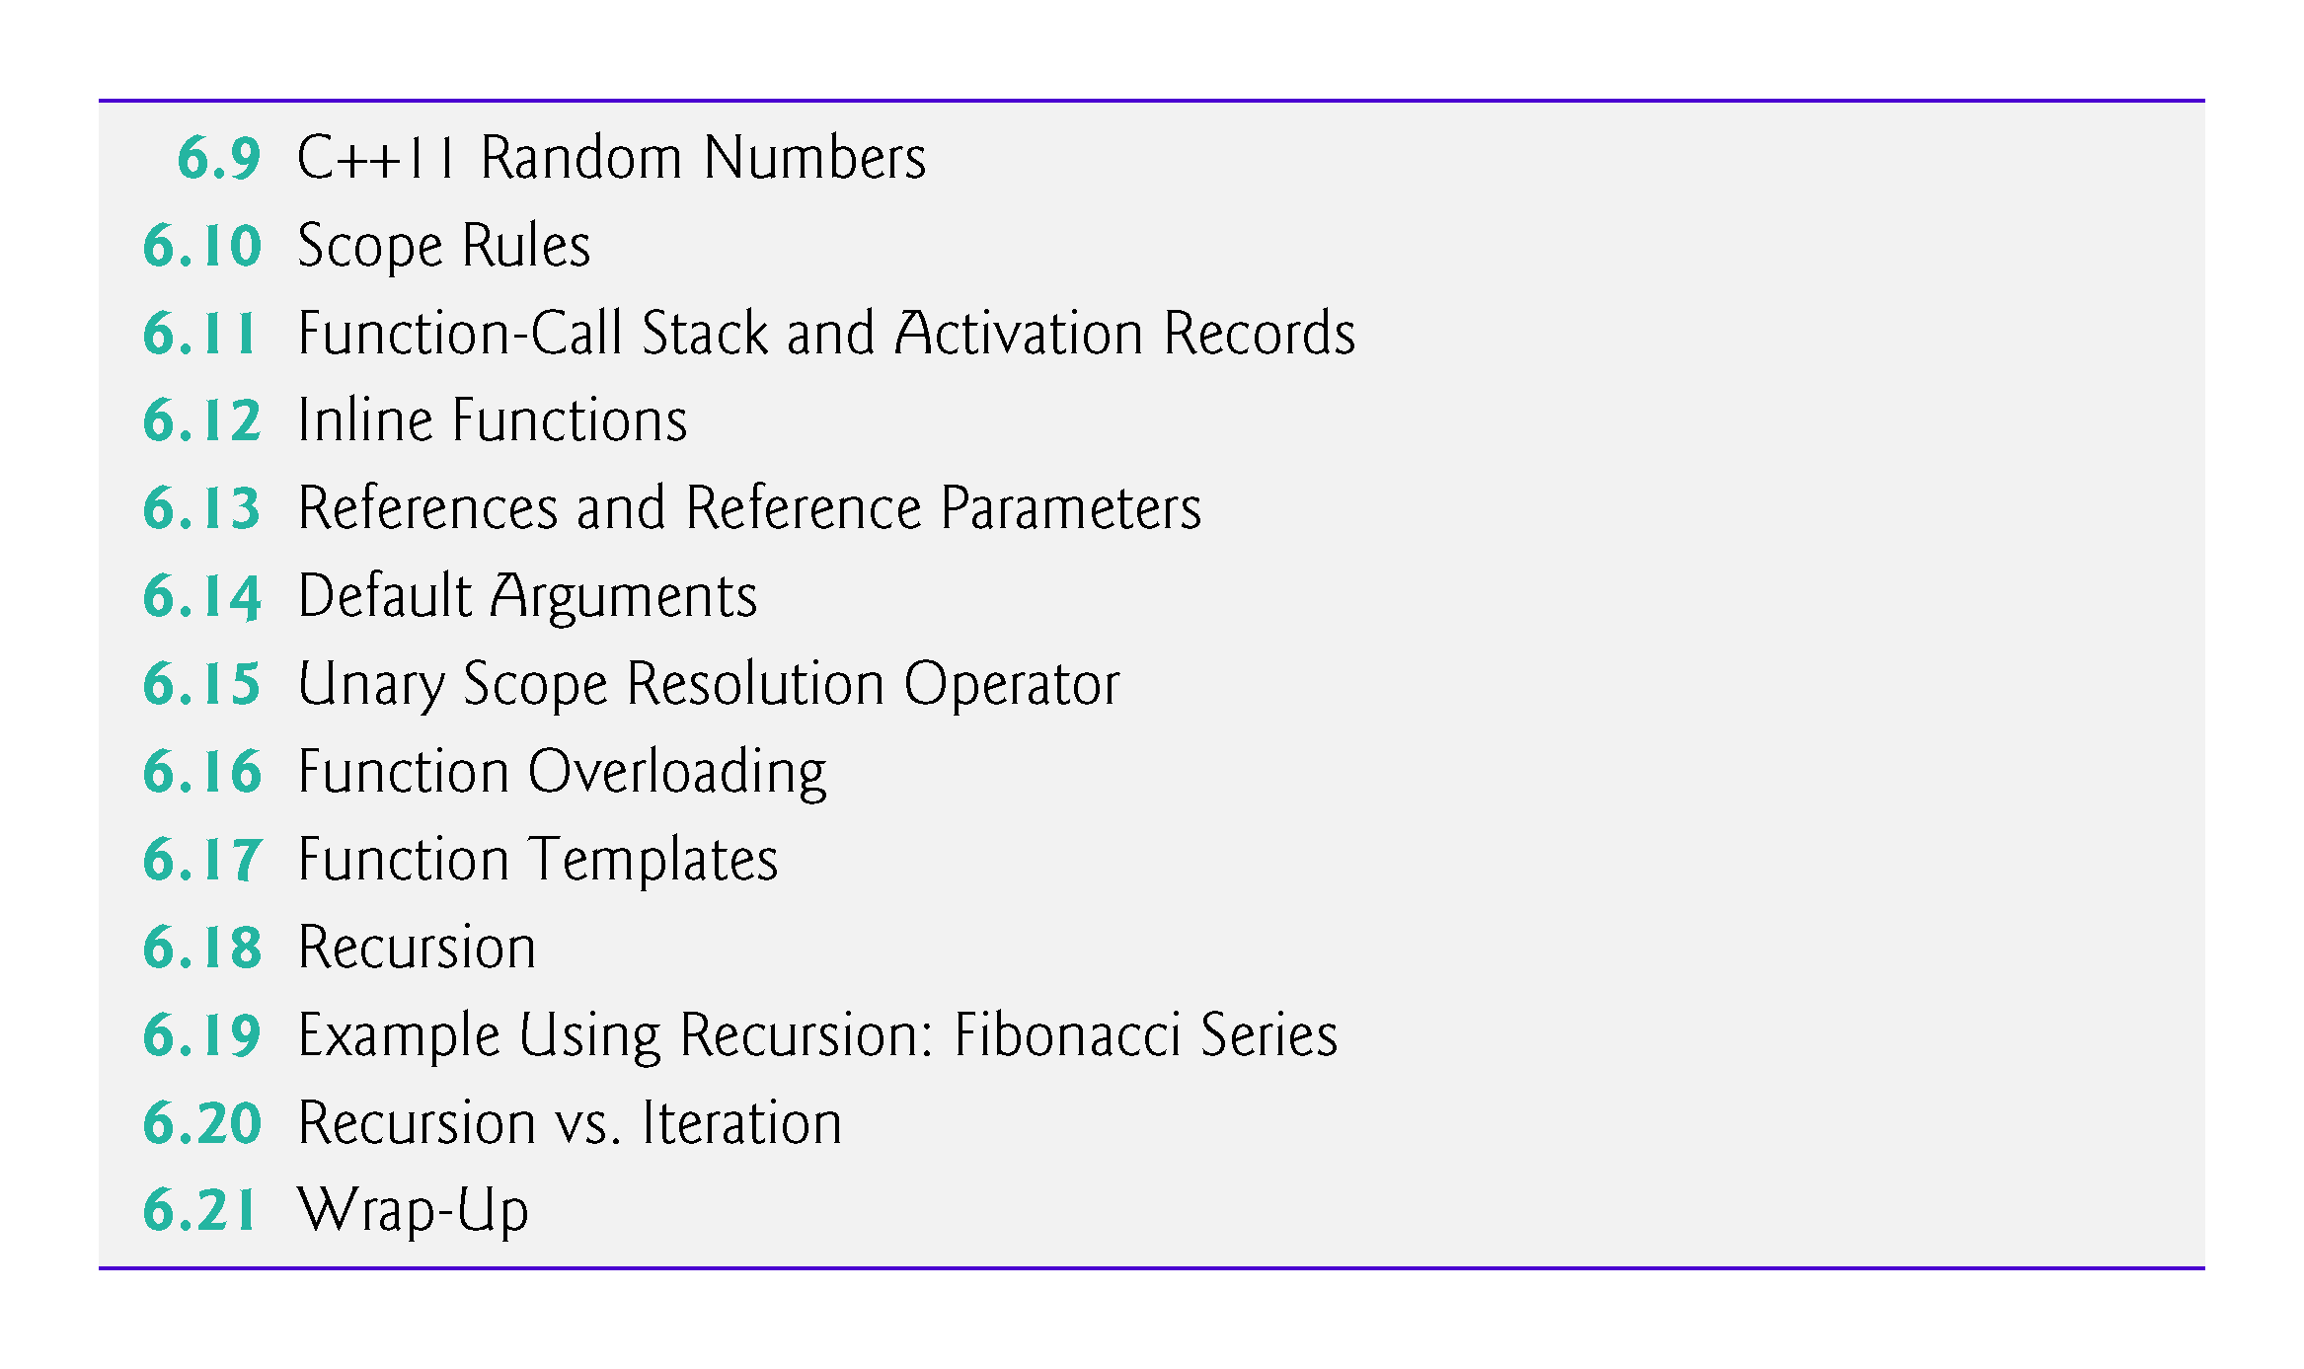
©1992-2017 by Pearson Education, Inc. All Rights Reserved.

Slide 5
6.1 Introduction
Develop and maintain a large program by constructing it from small, simple pieces, or components.
divide and conquer.
Emphasize how to declare and use functions to facilitate the design, implementation, operation and maintenance of large programs.
Function prototypes and how the compiler uses them to convert the type of an argument in a function call to the type specified in a function’s parameter list, if necessary.
Simulation techniques with random number generation.
C++’s scope rules.
©1992-2017 by Pearson Education, Inc. All Rights Reserved.

Slide 6
6.1 Introduction (cont.)
How C++ keeps track of which function is currently executing, how parameters and other local variables of functions are maintained in memory and how a function knows where to return after it completes execution.
Function overloading.
Function templates.
Recursion.
©1992-2017 by Pearson Education, Inc. All Rights Reserved.

Slide 7
6.2 Program Components in C++
C++ programs are typically written by combining “prepackaged” functions and classes available in the C++ Standard Library with new functions and classes you write.
The C++ Standard Library provides a rich collection of functions.
Functions allow you to modularize a program by separating its tasks into self-contained units.
©1992-2017 by Pearson Education, Inc. All Rights Reserved.

Slide 8
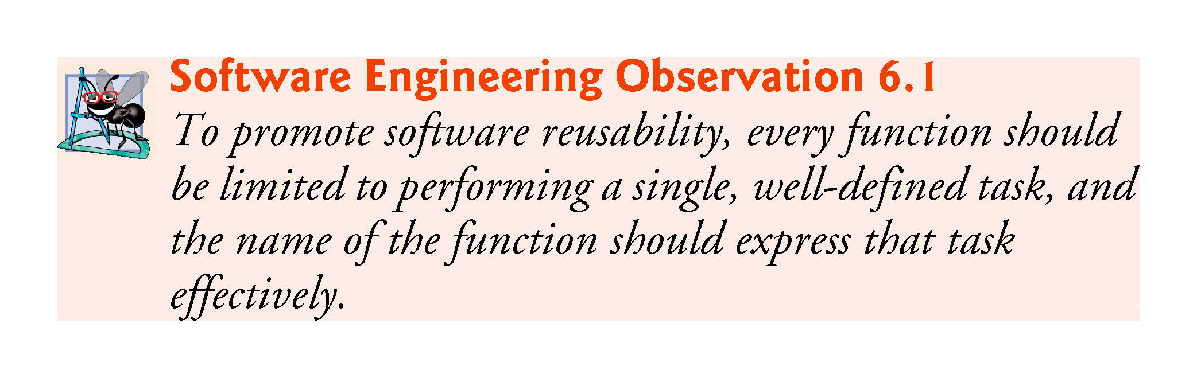
©1992-2017 by Pearson Education, Inc. All Rights Reserved.

Slide 9
6.2 Program Components in C++ (cont.)
A function is invoked by a function call, and when the called function completes its task, it either returns a result or simply returns control to the caller.
An analogy is the hierarchical form of management (Figure 6.1).
A boss (similar to the calling function) asks a worker (similar to the called function) to perform a task and report back (i.e., return) the results after completing the task.
The boss does not know how the worker performs its tasks.
The worker may also call other workers, unbeknownst to the boss.
This hiding of implementation details promotes good software engineering.
©1992-2017 by Pearson Education, Inc. All Rights Reserved.

Slide 10
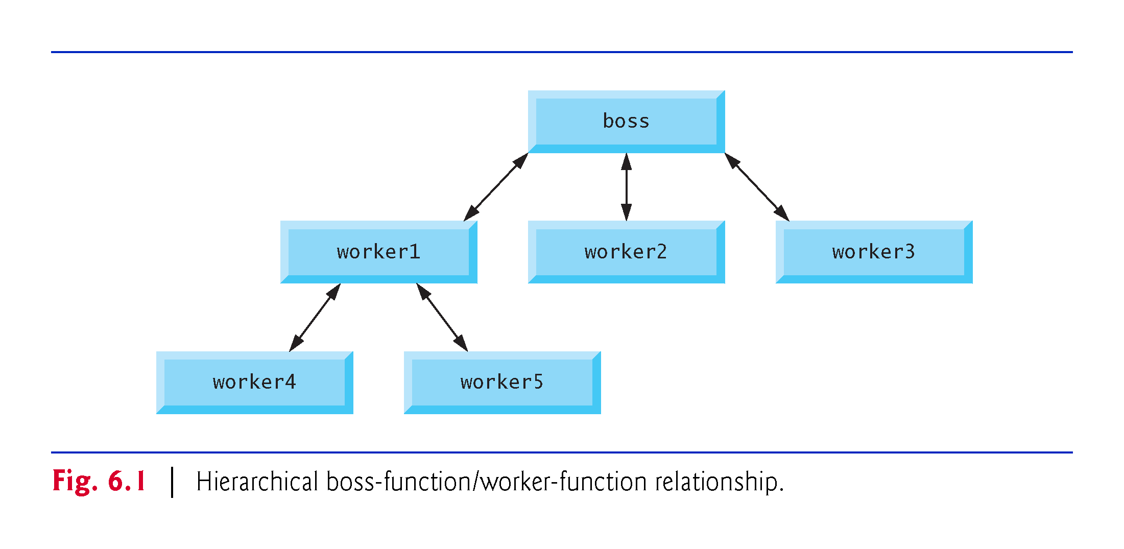
©1992-2017 by Pearson Education, Inc. All Rights Reserved.

Slide 11
6.3 Math Library Functions
Sometimes functions are not members of a class.
Called global functions.
The <cmath> header provides a collection of functions that enable you to perform common mathematical calculations.
All functions in the <cmath> header are global functions—therefore, each is called simply by specifying the name of the function followed by parentheses containing the function’s arguments.
©1992-2017 by Pearson Education, Inc. All Rights Reserved.

Slide 12
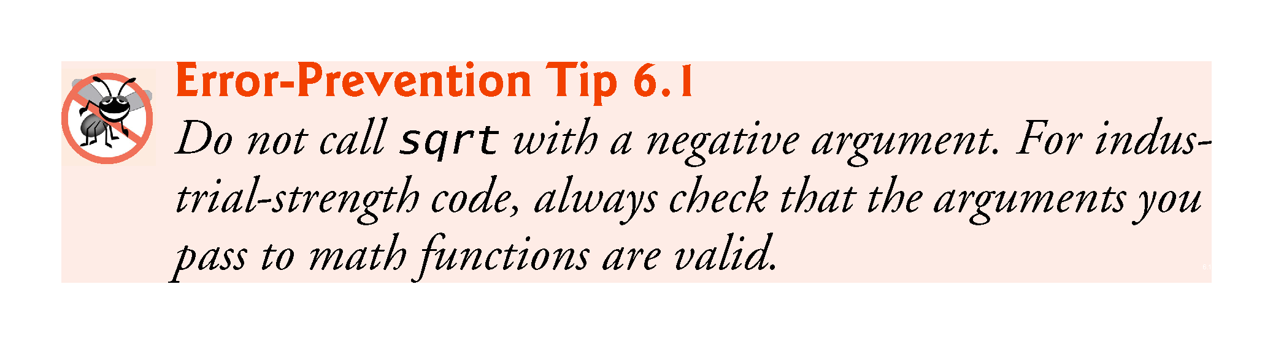
©1992-2017 by Pearson Education, Inc. All Rights Reserved.

Slide 13
6.3 Math Library Functions (cont.)
Some math library functions are summarized in Fig. 6.2.
In the figure, the variables x and y are of type double.
©1992-2017 by Pearson Education, Inc. All Rights Reserved.

Slide 14
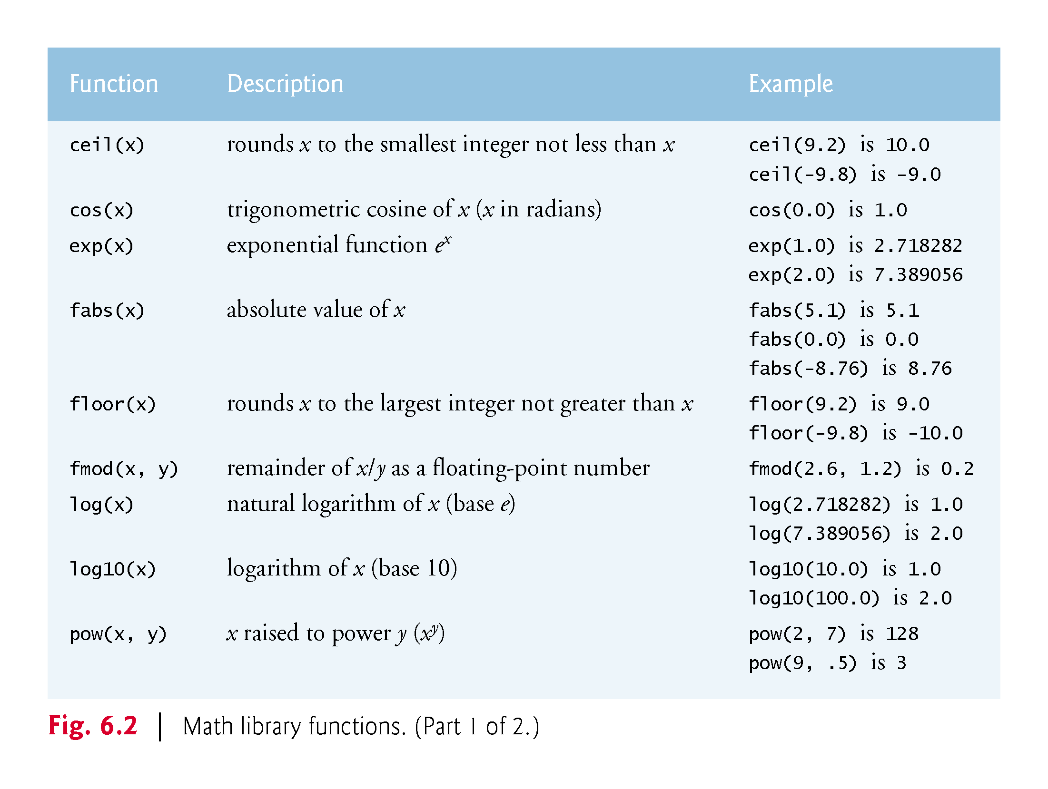
©1992-2017 by Pearson Education, Inc. All Rights Reserved.

Slide 15
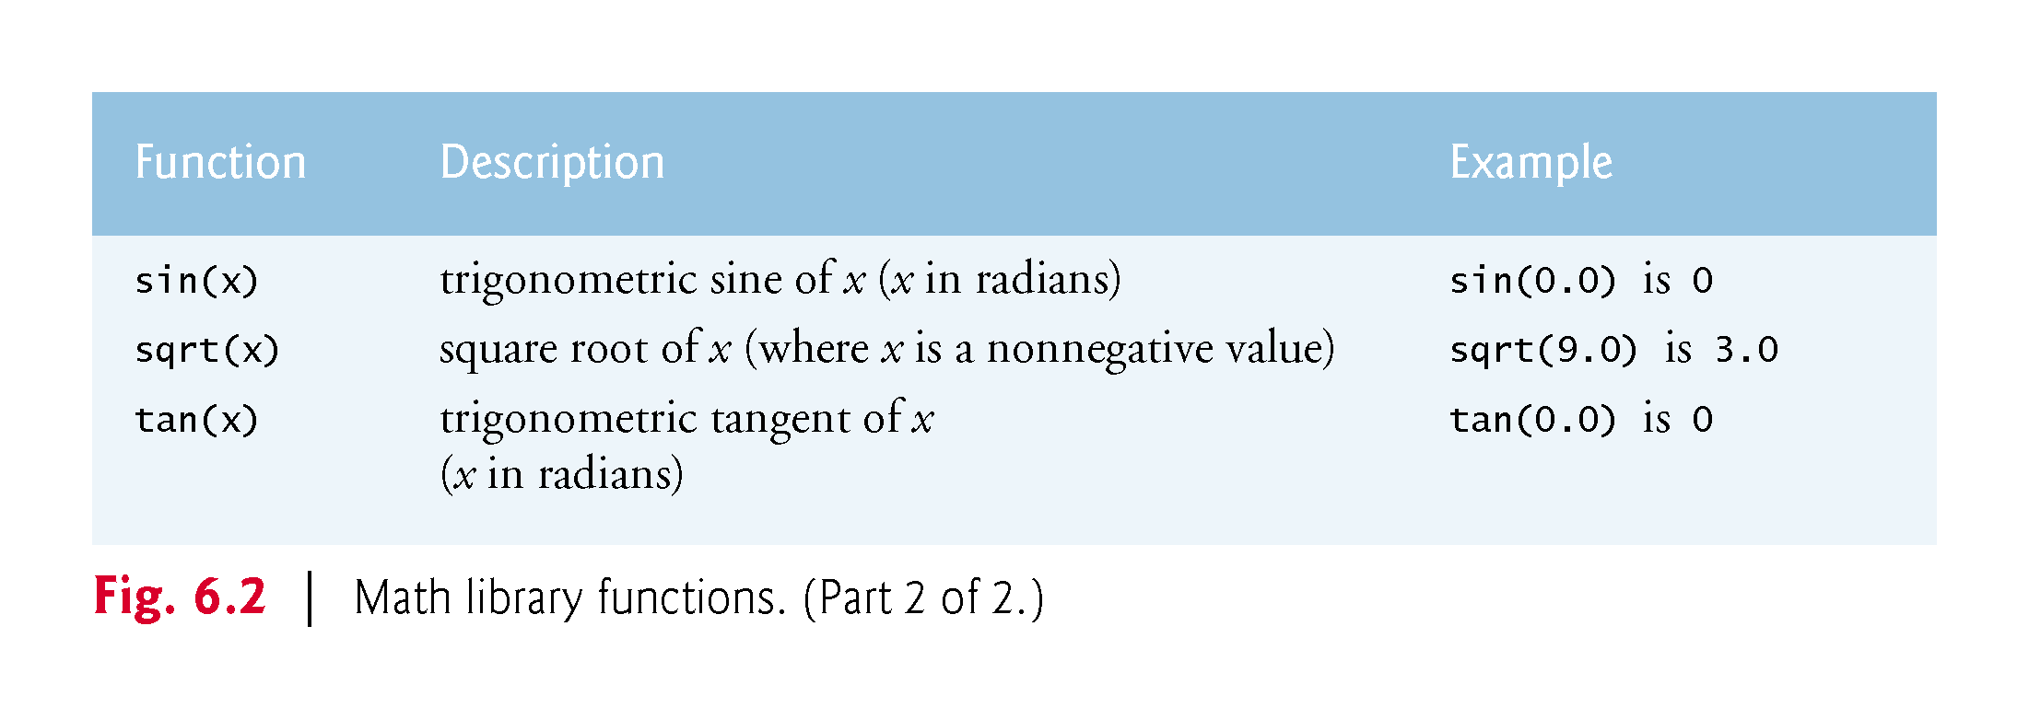
©1992-2017 by Pearson Education, Inc. All Rights Reserved.

Slide 16
6.4 Function Prototypes
In this section, we create a user-defined function called maximum (Fig. 6.3) that returns the largest of its three int arguments.
©1992-2017 by Pearson Education, Inc. All Rights Reserved.

Slide 17
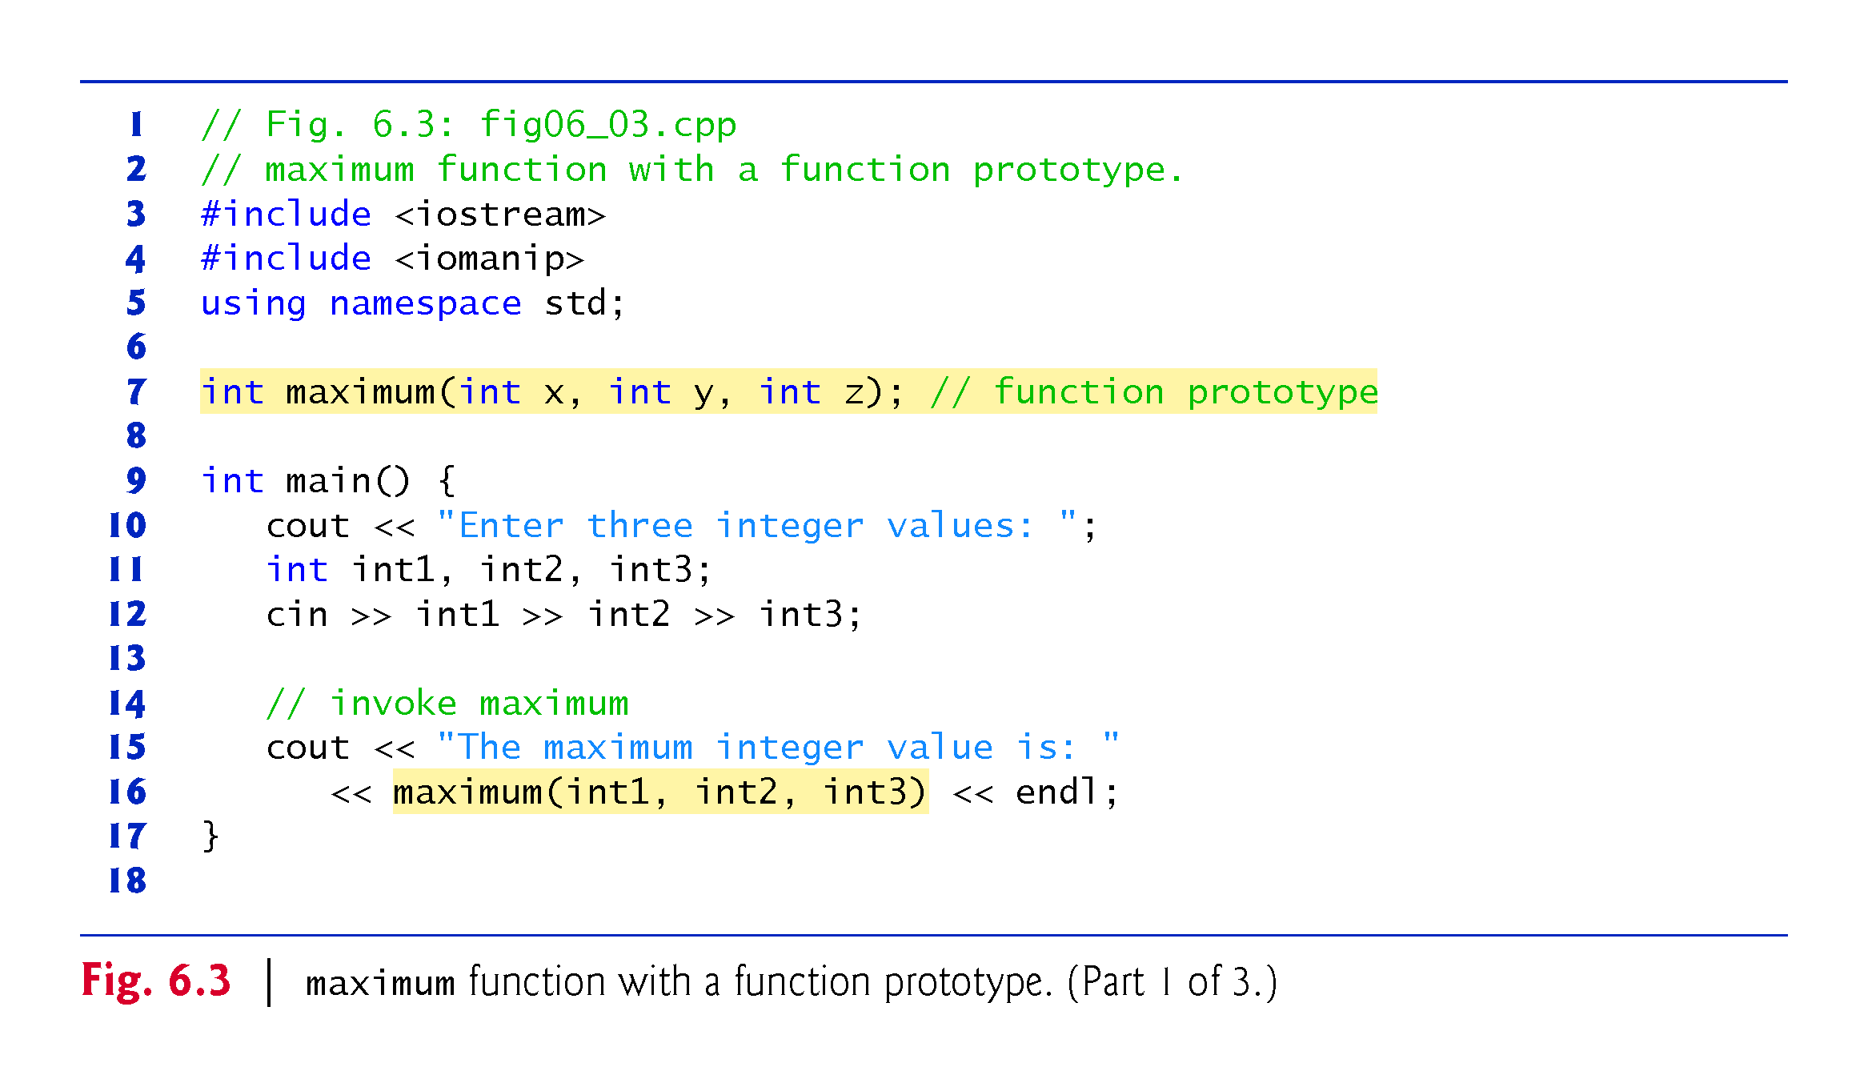
©1992-2017 by Pearson Education, Inc. All Rights Reserved.

Slide 18
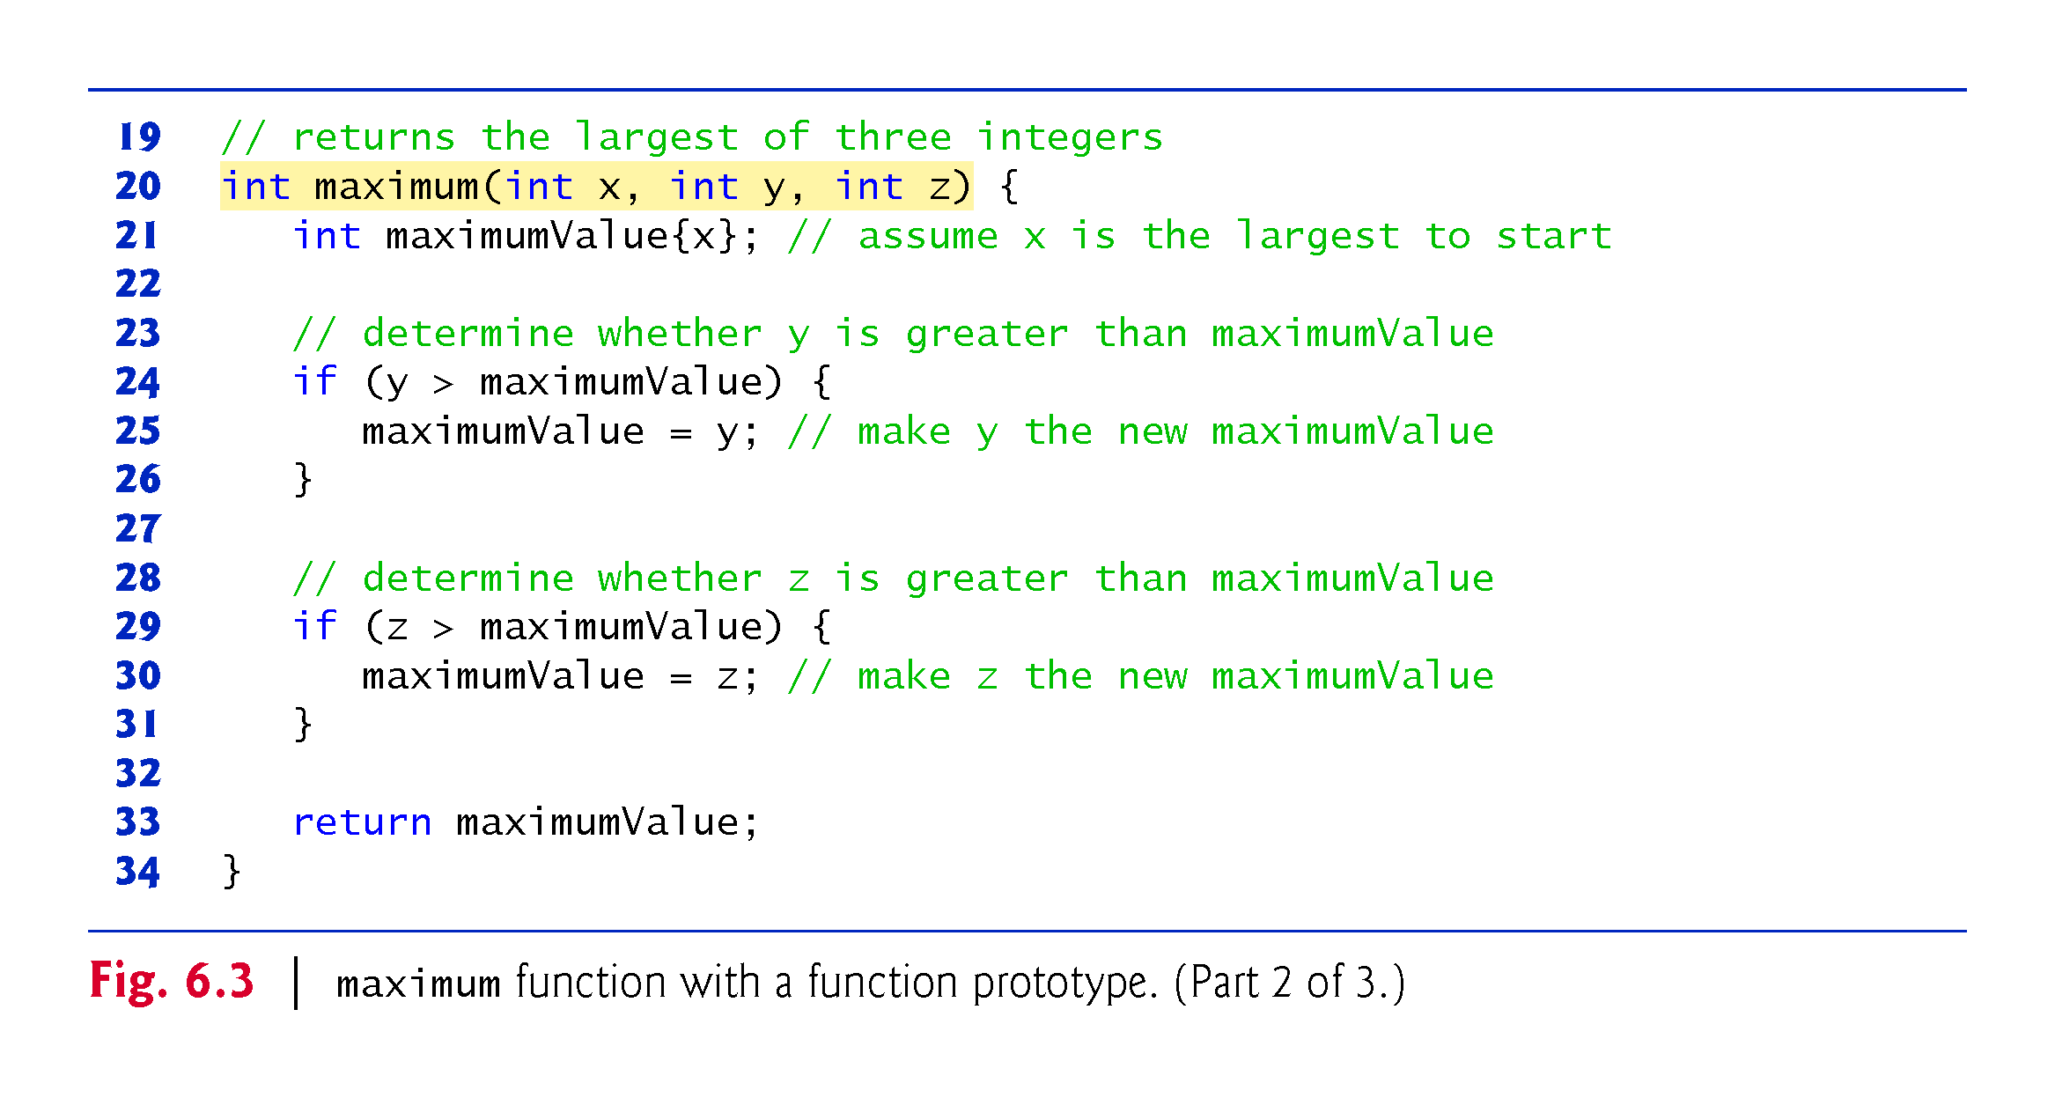
©1992-2017 by Pearson Education, Inc. All Rights Reserved.

Slide 19
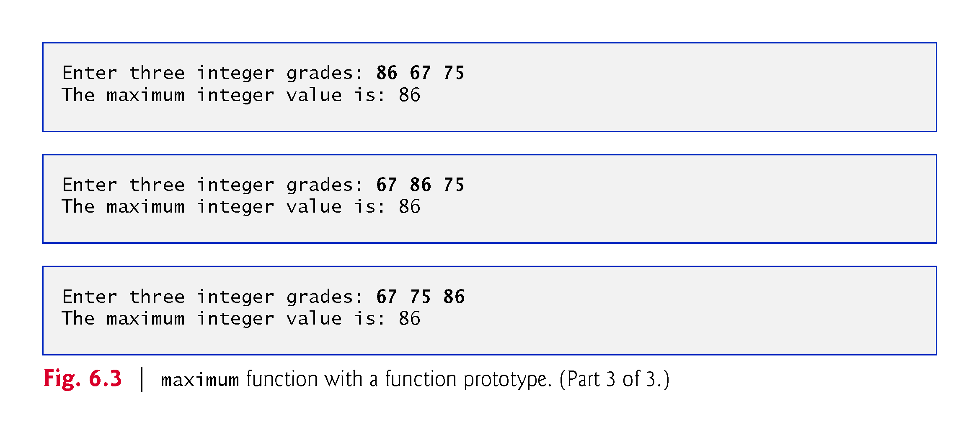
©1992-2017 by Pearson Education, Inc. All Rights Reserved.

Slide 20
6.4 Function Prototypes (cont.)
In preceding chapters, we created classes with various member functions.
We defined each class in a header (.h) and included it before main in a program’s source-code file.
Doing this ensures that the class (and thus its member functions) is defined before main creates and manipulates objects of that class.
The compiler then can ensure that we call each class’s constructors and member functions correcly—for example, passing each the correct number and types of arguments.
©1992-2017 by Pearson Education, Inc. All Rights Reserved.

Slide 21
6.4 Function Prototypes (cont.)
A function prototype is a declaration of a function
tells the compiler the function’s name, its return type and the types of its parameters. .
The function prototype is the same as the first line of the corresponding function definition (line 20), but ends with a required semicolon.
©1992-2017 by Pearson Education, Inc. All Rights Reserved.

Slide 22
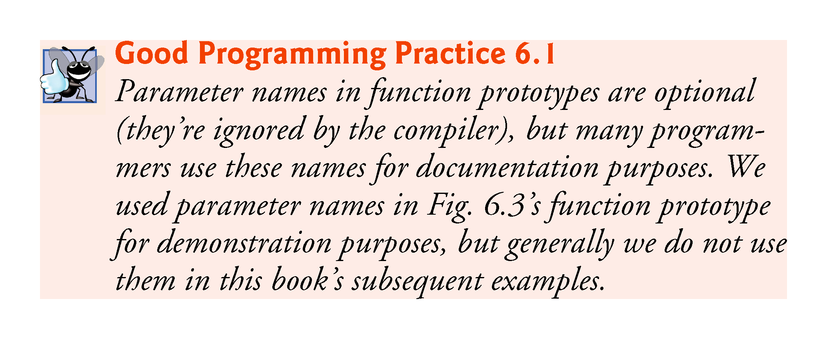
©1992-2017 by Pearson Education, Inc. All Rights Reserved.

Slide 23
6.4 Function Prototypes (cont.)
When compiling the program, the compiler uses the prototype to
Ensure that maximum’s first line matches its prototype.
Check that the call to maximum contains the correct number and types of arguments, and that the types of the arguments are in the correct order.
Ensure that the value returned by the function can be used correctly in the expression that called the function.
Ensure that each argument is consistent with the type of the corresponding parameter.
If the arguments passed to a function do not match the types specified in the function’s prototype, the compiler attempts to convert the arguments to those types.
©1992-2017 by Pearson Education, Inc. All Rights Reserved.

Slide 24
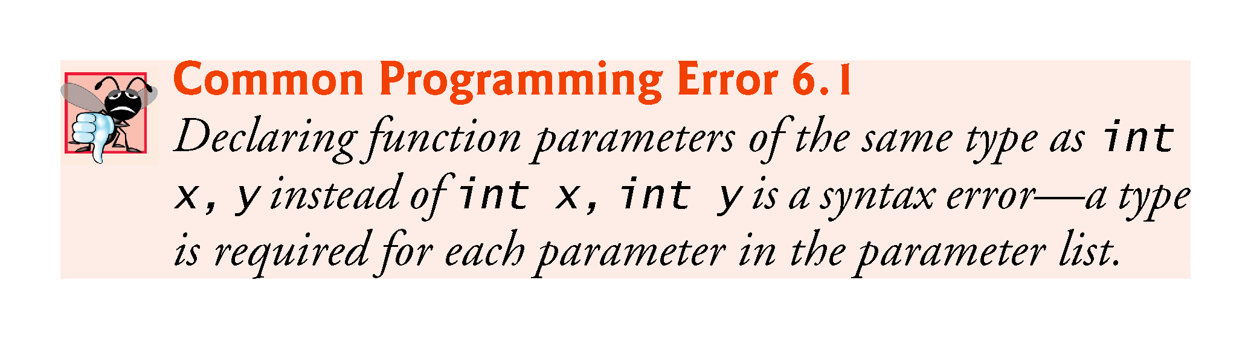
©1992-2017 by Pearson Education, Inc. All Rights Reserved.

Slide 25
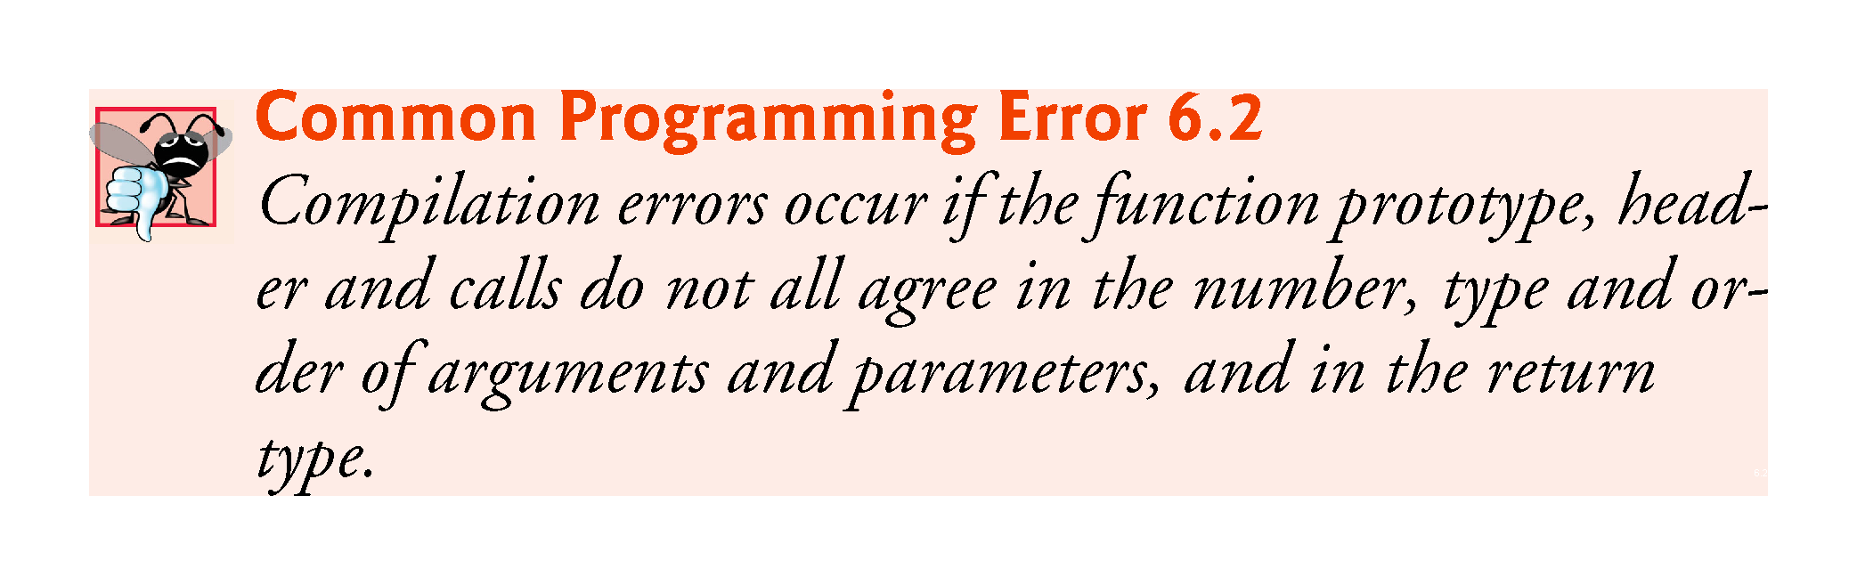
©1992-2017 by Pearson Education, Inc. All Rights Reserved.

Slide 26
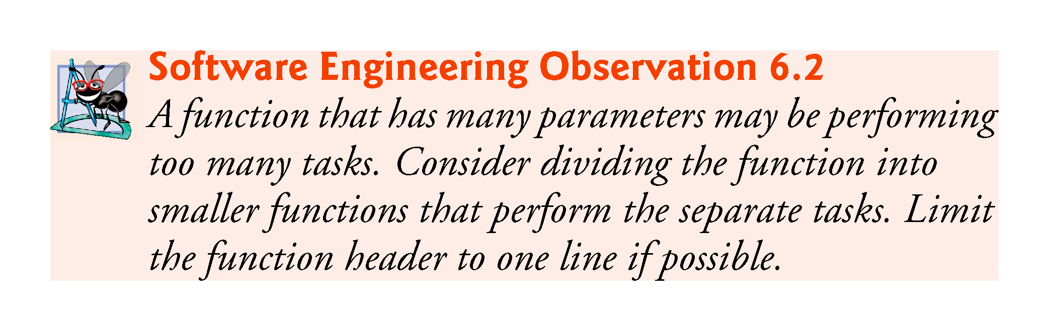
©1992-2017 by Pearson Education, Inc. All Rights Reserved.

Slide 27
6.4 Function Prototypes (cont.)
Multiple parameters are specified in both the function prototype and the function header as a comma-separated list, as are multiple arguments in a function call.
©1992-2017 by Pearson Education, Inc. All Rights Reserved.

Slide 28
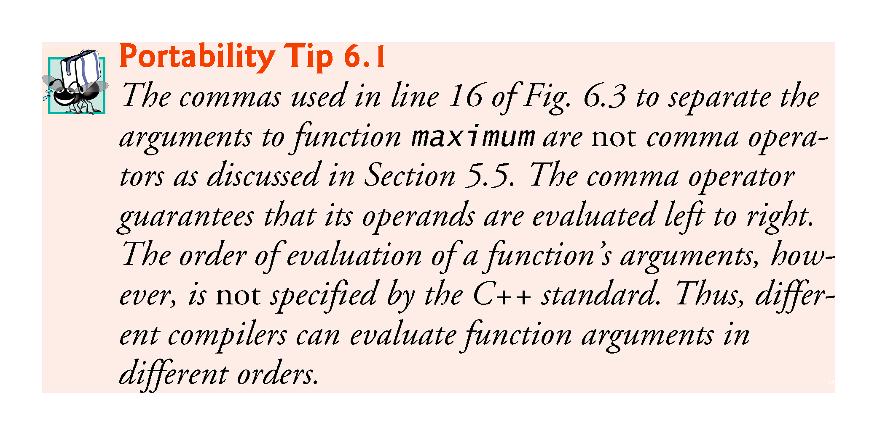
©1992-2017 by Pearson Education, Inc. All Rights Reserved.

Slide 29
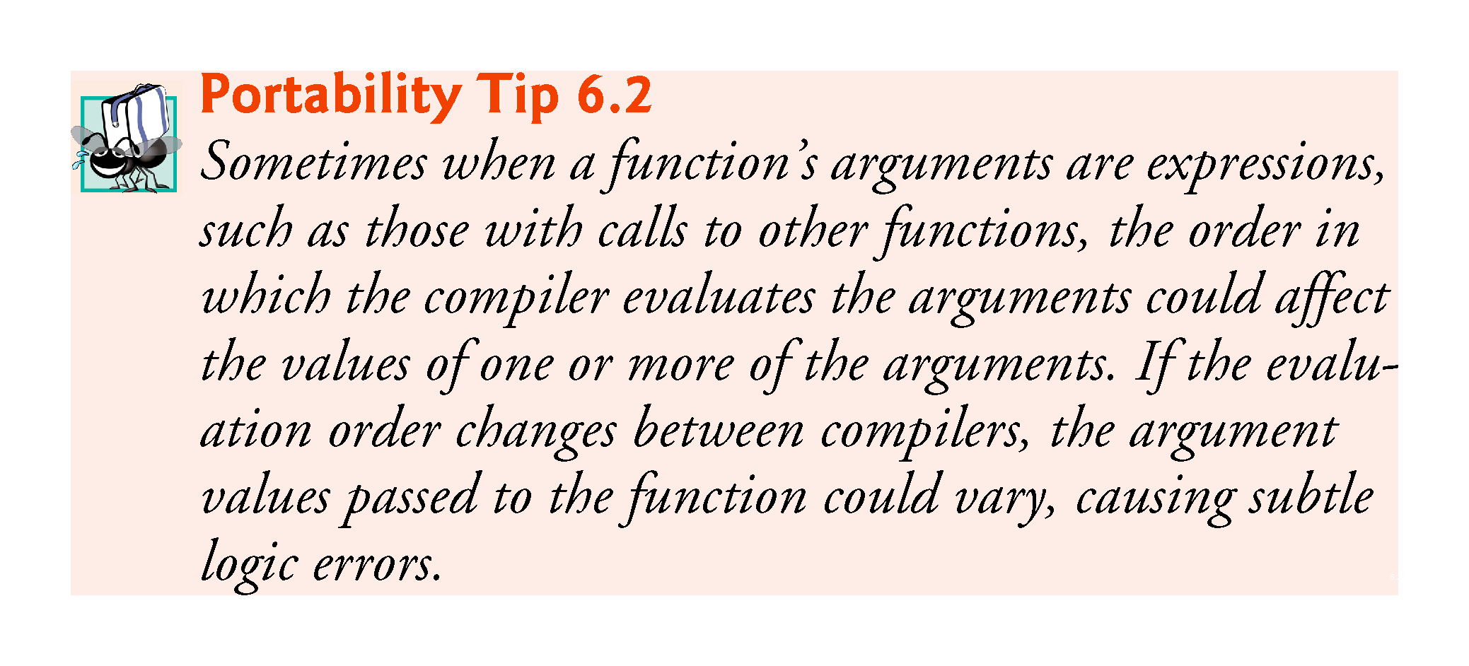
©1992-2017 by Pearson Education, Inc. All Rights Reserved.

Slide 30
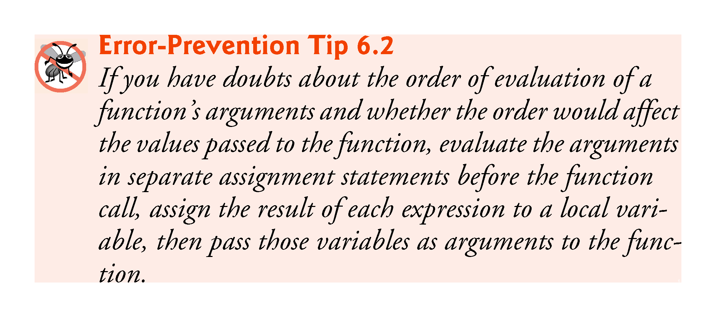
©1992-2017 by Pearson Education, Inc. All Rights Reserved.

Slide 31
6.4 Function Definitions with Multiple Parameters (cont.)
In a function that does not return a result (i.e., it has a void return type), we showed that control returns when the program reaches the function-ending right brace.
You also can explicitly return control to the caller by executing the statement
return;
©1992-2017 by Pearson Education, Inc. All Rights Reserved.

Slide 32
Basic exercises
Write a function “cube” that takes an integer and outputs the cube of the output.
Write a function “power” that takes a double x and an integer pow and outputs x ^{power} (use a for loop, do not use pow).
Write a function “concatenate” with void output that takes two strings and couts one string next to the other (that is, for example, concatenate(foo, yee) will print out fooyee).
©1992-2017 by Pearson Education, Inc. All Rights Reserved.

Slide 33
6.5 Function-Prototypes and Argument-Coercion Notes
A function prototype is required unless the function is defined before it’s used.
When you use a standard library function like sqrt, you do not have access to the function’s definition, therefore it cannot be defined in your code before you call the function.
Instead, you must include its corresponding header (<cmath>), which contains the function’s prototype.
©1992-2017 by Pearson Education, Inc. All Rights Reserved.

Slide 34
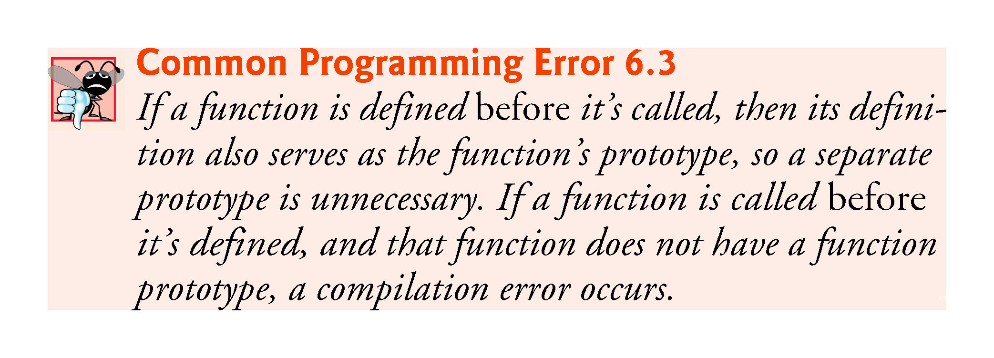
©1992-2017 by Pearson Education, Inc. All Rights Reserved.

Slide 35
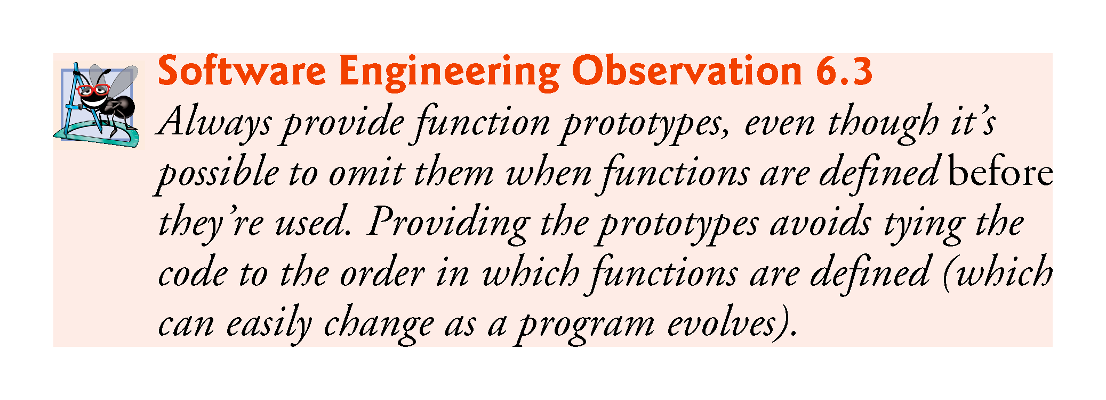
©1992-2017 by Pearson Education, Inc. All Rights Reserved.

Slide 36
6.5.1 Function Signatures and Function Prototypes
The portion of a function prototype that includes the name of the function and the types of its arguments is called the function signature or simply the signature.
Signature does not specify the function’s return type.
The scope of a function is the region of a program in which the function is known and accessible.
©1992-2017 by Pearson Education, Inc. All Rights Reserved.

Slide 37
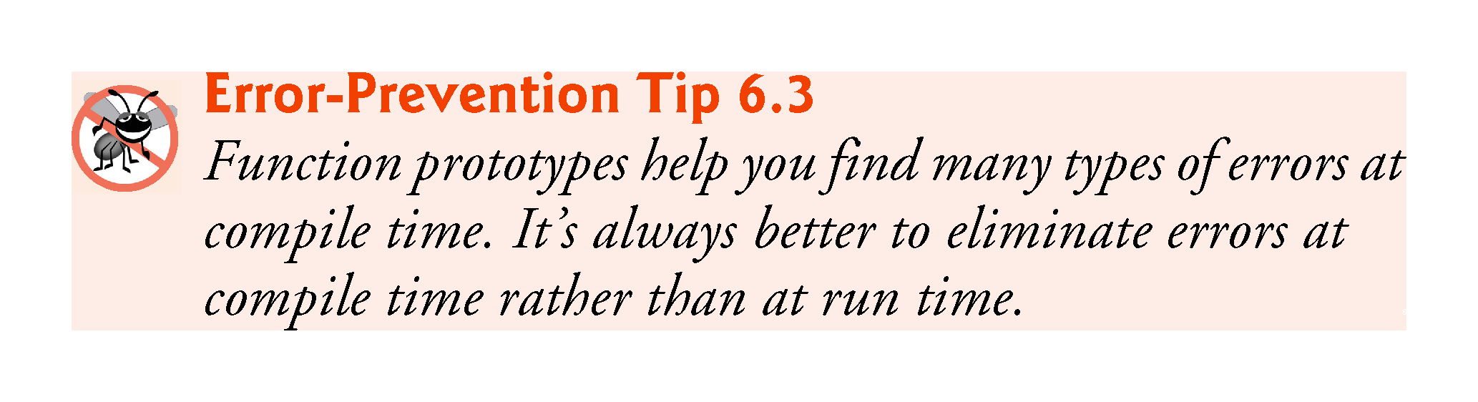
©1992-2017 by Pearson Education, Inc. All Rights Reserved.

Slide 38
6.5.2 Argument Coercion
An important feature of function prototypes is argument coercion
forcing arguments to the appropriate types specified by the parameter declarations.
These conversions occur as specified by C++’s promotion rules.
©1992-2017 by Pearson Education, Inc. All Rights Reserved.

Slide 39
6.5.3 Argument-Promotion Rules and Implicit Conversions
The promotion rules indicate how to convert between types without losing data.
The promotion rules apply to expressions containing values of two or more data types
also referred to as mixed-type expressions.
The type of each value in a mixed-type expression is promoted to the “highest” type in the expression.
©1992-2017 by Pearson Education, Inc. All Rights Reserved.

Slide 40
6.5.3 Argument-Promotion Rules and Implicit Conversions
Figure 6.4 lists the arithmetic data types in order from “highest type” to “lowest type.”
Converting values to lower fundamental types can result in incorrect values.
Therefore, a value can be converted to a lower fundamental type only by explicitly assigning the value to a variable of lower type or by using a cast operator.
©1992-2017 by Pearson Education, Inc. All Rights Reserved.

Slide 41
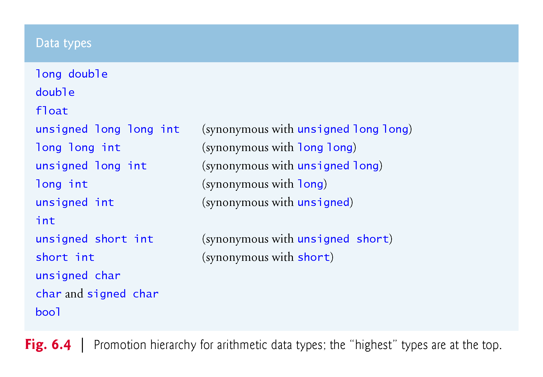
©1992-2017 by Pearson Education, Inc. All Rights Reserved.

Slide 42
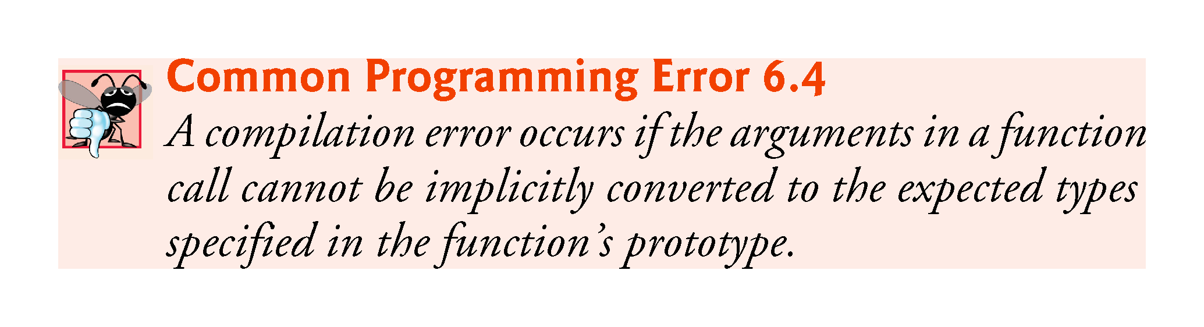
©1992-2017 by Pearson Education, Inc. All Rights Reserved.

